Slide 1

Lesson 4: Website Planning and Design
Dr Fadi Safieddine
1
Dr. Fadi Safieddine copyright 2021

Slide 2
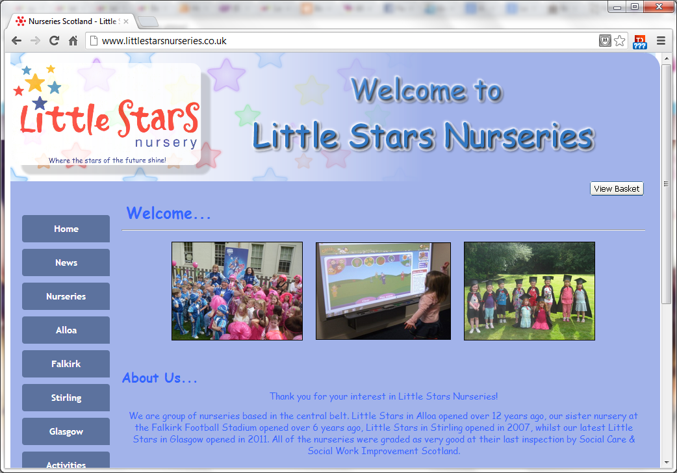
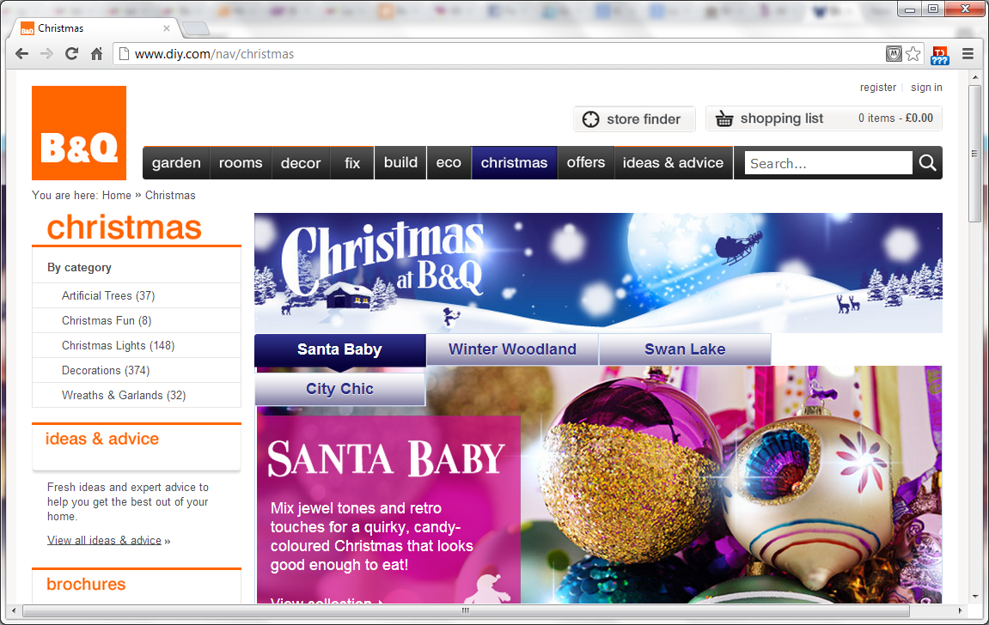
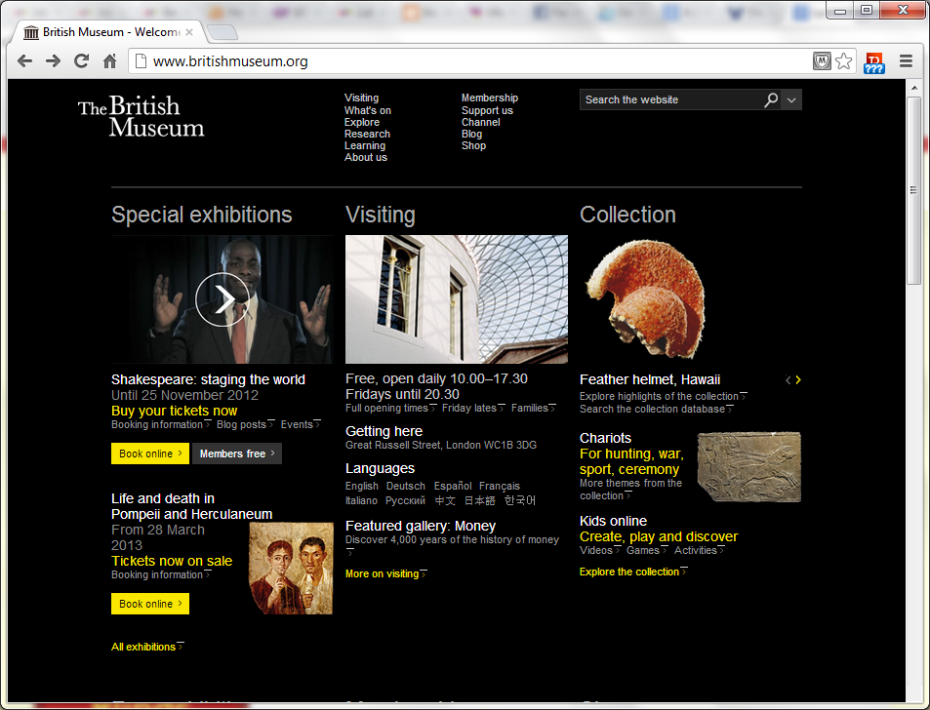
Lecture content
Requirement Analysis:
Research subject and customers.
Navigation designs.
Layout design.
Design themes:
background, fonts, and colours.
Testing the design.
Documentation.
2

Slide 3

Requirement Analysis
Designing a good website requires more than just putting together a few pages.
One of the first things you need to do is “research”.
Look at websites of the same industry.
Consider your customers.
Make a list of the clients’ requirements.
Many times, the client does not really know what they want but they know what they do not want.
3

Slide 4
Requirement Analysis
Writing a plan with milestones.
Arranging regular visits and demos.
Signing agreed changes – to protect you!
Some of the tools you can use:
Structured:
Use-Case Diagram (for interactions)
Flow Charts (for scripts)
Gantt Chart (for plans)
Unstructured:
Descriptive and sketches
4

Slide 5
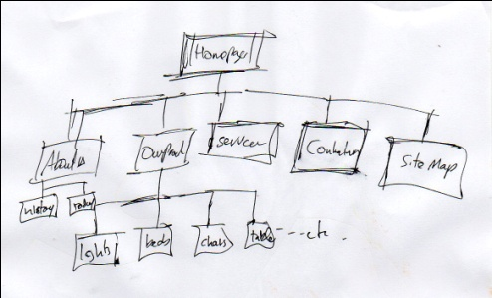
Navigation & Structure:
Selecting the right navigation is very important.
Poor navigation design would make:
Navigation Difficult
Cause customers to lose interest:
Some studies suggest web users have a tolerance of less than 8 seconds to find the information they want.
Project lack of professionalism and/or lack of credibility of the business.
Note: Whatever navigational structure you select it is common practice to call the first page (or Home Page) index.html.
5

Slide 6
Web Page Navigation:
Index
About Us
Our Products
Locate Us
Contact Us
Simple navigational structure
6

Slide 7
Web Page Navigation:
Index
About Us
Our Products
Locate Us
Contact Us
Product1
Product2
Product3
Buy Now
Buy Now
Preorder
Login
Account
Balance
Logout
Multi-level navigational structure
7

Slide 8
Web Page Navigation:
Linear navigational structure
Although there should always be option to cancel or go back.
Search flight
Select flight
Input details &Credit card
Preview Order
Confirmation Page
8

Slide 9
Web Page Navigation
Quiz Home Page
Quiz 1
Quiz 2
Quiz 3
Quiz 4
Quiz 5
Star navigational structure
9

Slide 10
Web Page Navigation:
Web-linked Site:
Where almost all the pages interlink.
Home Page
Themes
Publishers
Books
Authors
10

Slide 11
End of part: 1
Activity 4.1: For each of these case studies, select the most appropriate navigational structure:
A Game website, where you need to move from one level to another.
A Museum website, where you can go to individual subjects but have to return to the ‘main’ hall.
A Business website that is well structured.
A personal page of a book author.

Slide 12
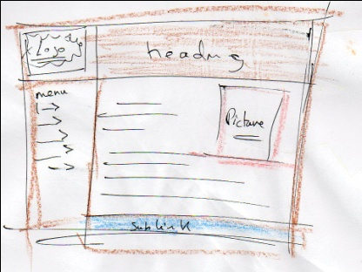
Web Page Layout
Part 2

Slide 13
Web Page Layout
Sections of a web page (in order of importance):
Content
Could be one section or divided to several sub columns or several sub rows.
Heading
Title, menu links, adverts, and/or upper sub links.
Left side column
Menu links or Adverts
Footer
Copy right and/or sub links
Right Side Column
More content, adverts, and/or further links – But NEVER MAIN LINKS.
Search Area
Tends to be required for medium to large businesses.

Slide 14
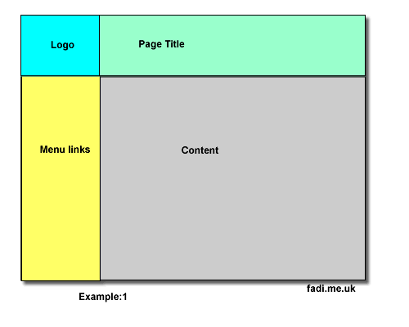
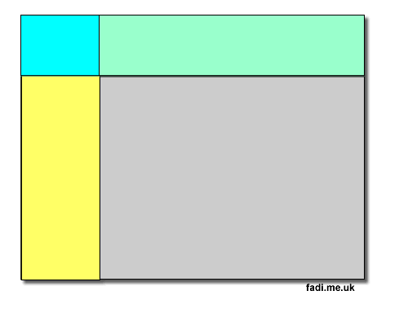
Basic Structure: Four Divisions
Aligned structure

Slide 15
Basic Structure: Four Divisions

Slide 16
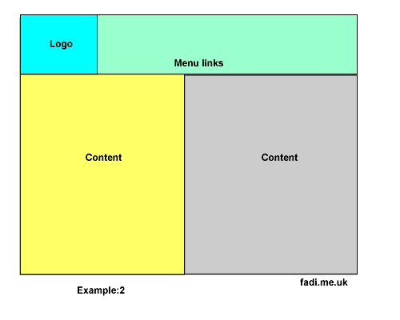
Basic Structure: Four Divisions
Misaligned structure.
16

Slide 17
Basic Structure: Four Divisions
17

Slide 18
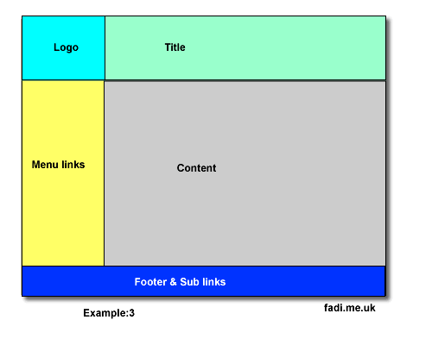
Structure: Five Divisions
Aligned structure
18

Slide 19
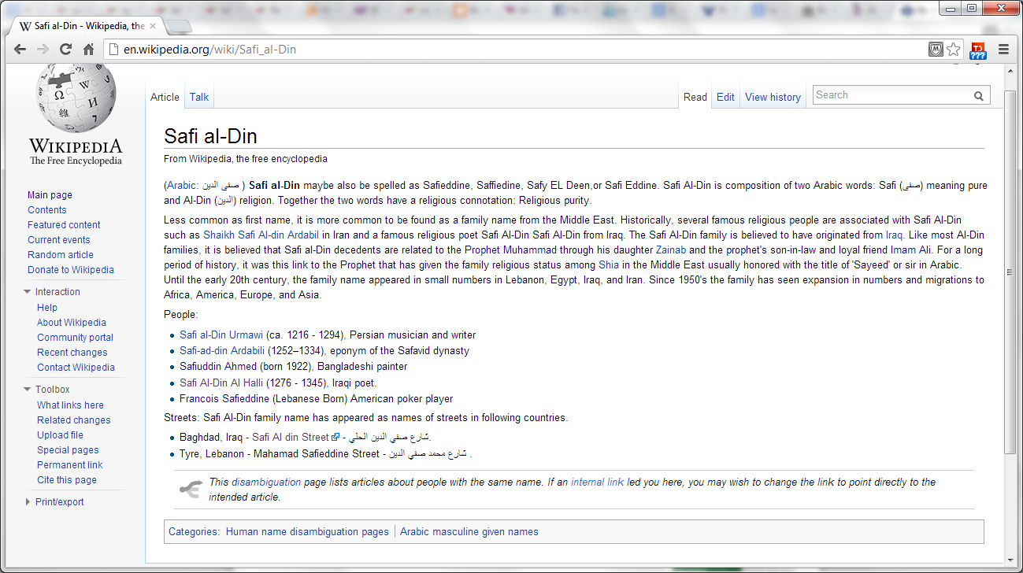
19

Slide 20
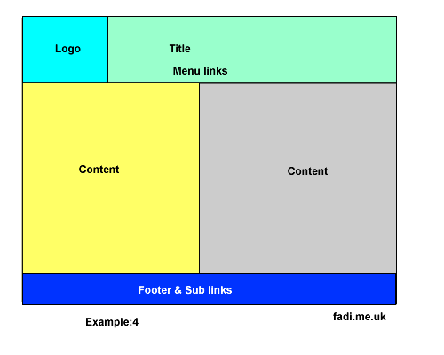
Structure: Five Divisions
Misaligned Structure
20

Slide 21
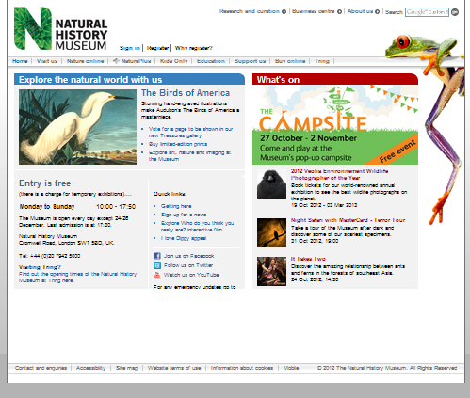
Structure: Five Divisions
21

Slide 22
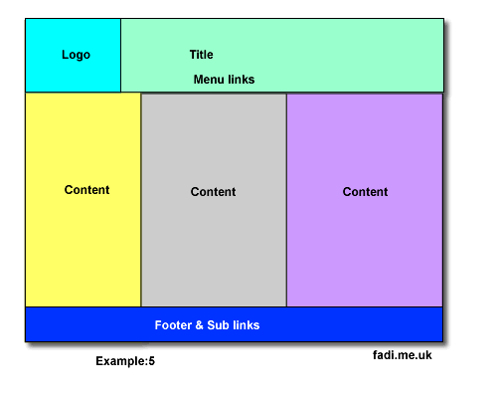
Structure: Six Divisions
22

Slide 23
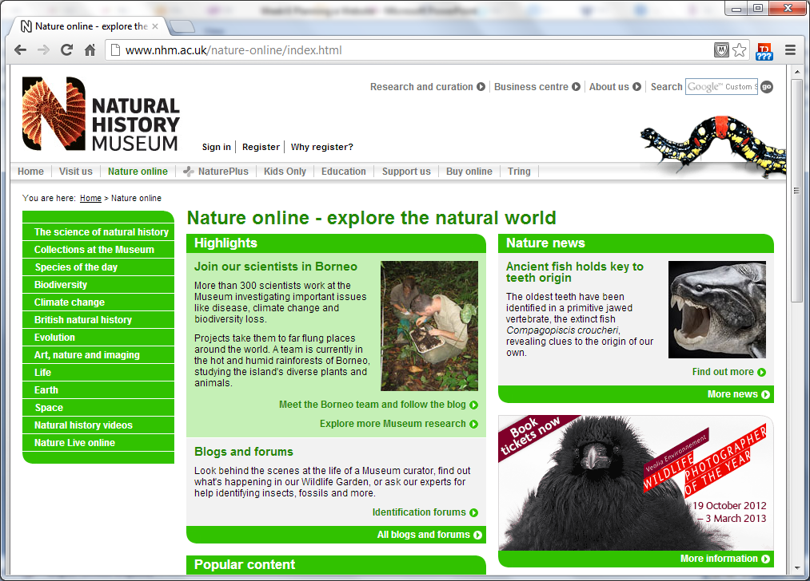
Structure: Six Divisions
23

Slide 24
Layout: Multi-Division
You can use your creativity here.
You can have many ways to design your layout but always consider if you are making it too complex.
The more divisions you make the more likely you will have problems when testing it against different browsers.
Only regular testing with clients and customers can ensure you get it right.
24

Slide 25
Layout: Multi-Division
25

Slide 26
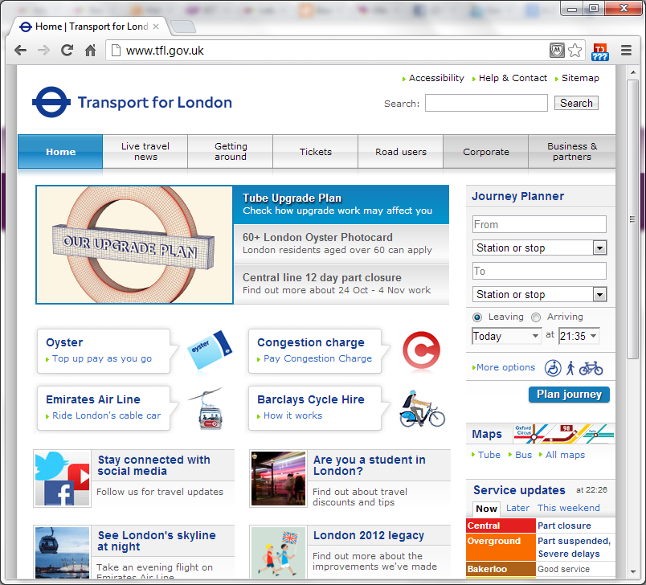
Layout: Multi-Division
26

Slide 27
Layout Design: Nested Divisions
Complex Layouts:
All those layout can be nested in a bigger Division that would contain a colourful background or just plain white space.
Some of the divisions can have nested division within as well.
This does make the layout complex but may enhance the presentation of the website.
Sizing the Divisions:
monitors differ in their resolutions: 640x480, 800x600, 1024x768. Thus, pages may look different.
You can use a % width of the screen: example make it 80% of the page width so it would resize.
You can use a pixel width: example make it 500px. This would not resize.
27

Slide 28
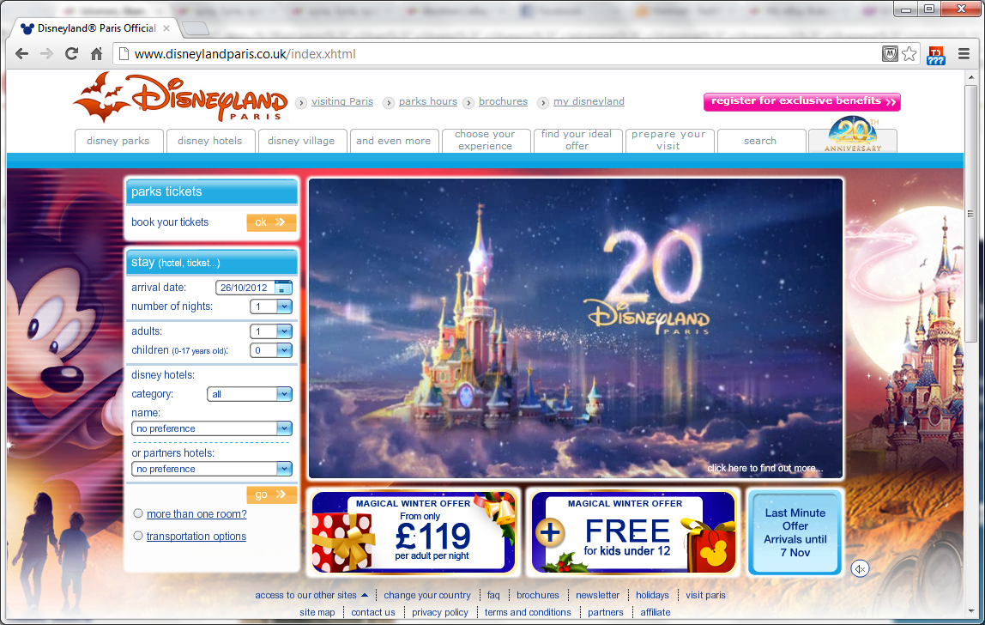
Layout Design: Nested Divisions
28

Slide 29
End of part 2:
Activity 4.2. Which layout will you choose for your assignment ‘Bicycle rental system’.
Next week, your tutor will let you know what the majority picked.

Slide 30
Design Themes:
Part 3
30

Slide 31
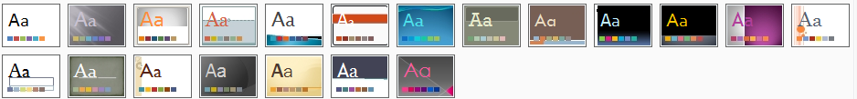
Design Themes:
Design themes refers to selecting a set of themes that complement each other and be consistent across the whole website:
Background
Colour codes
Fonts: Sizes, Type, Colours, and Style.
Headings 1-6
Paragraphs:
It is Good practice to define these at start of the project as working document to be reflected in the CSS file.
31

Slide 32
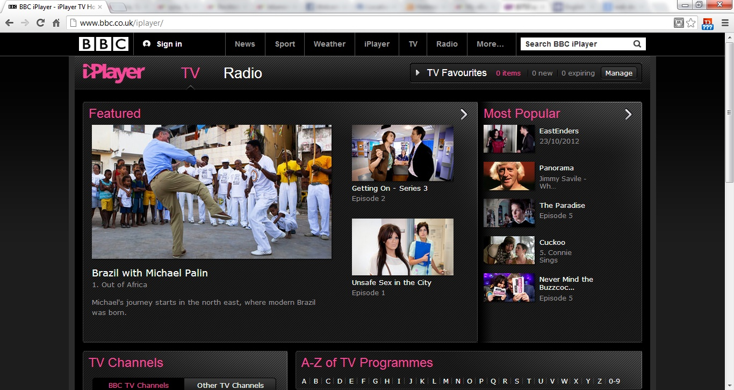
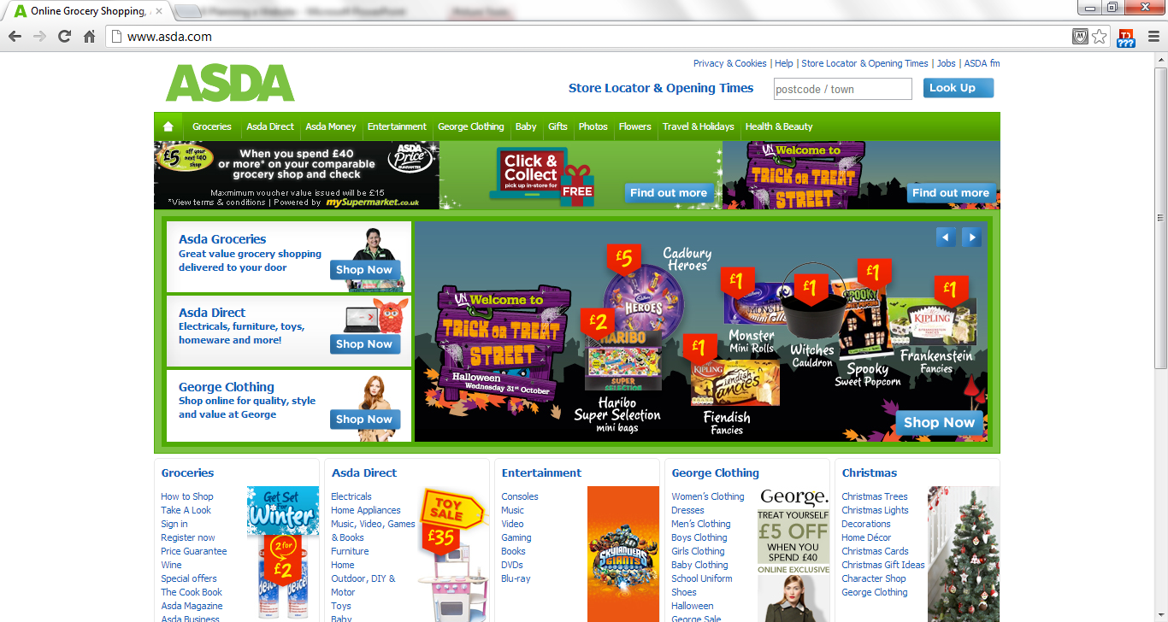
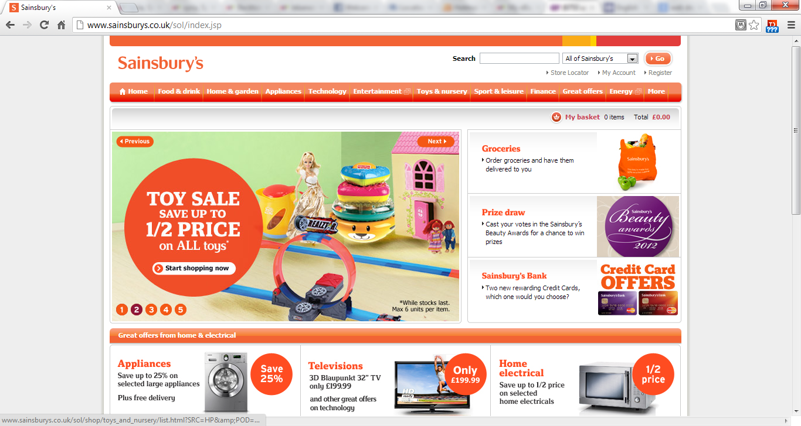
Design Theme Example:
32

Slide 33

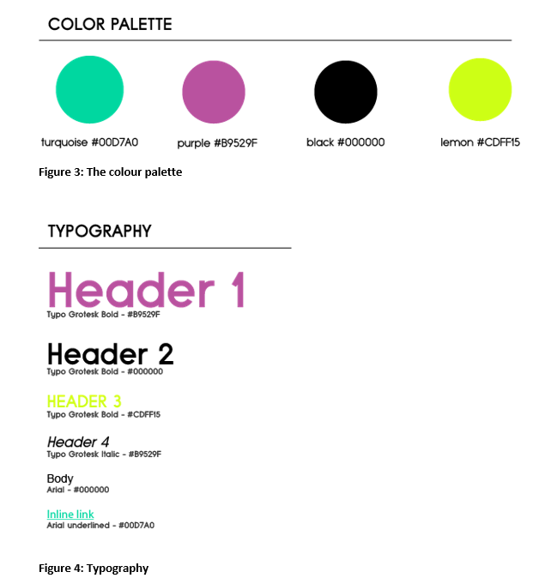
Design Themes:
33

Slide 34
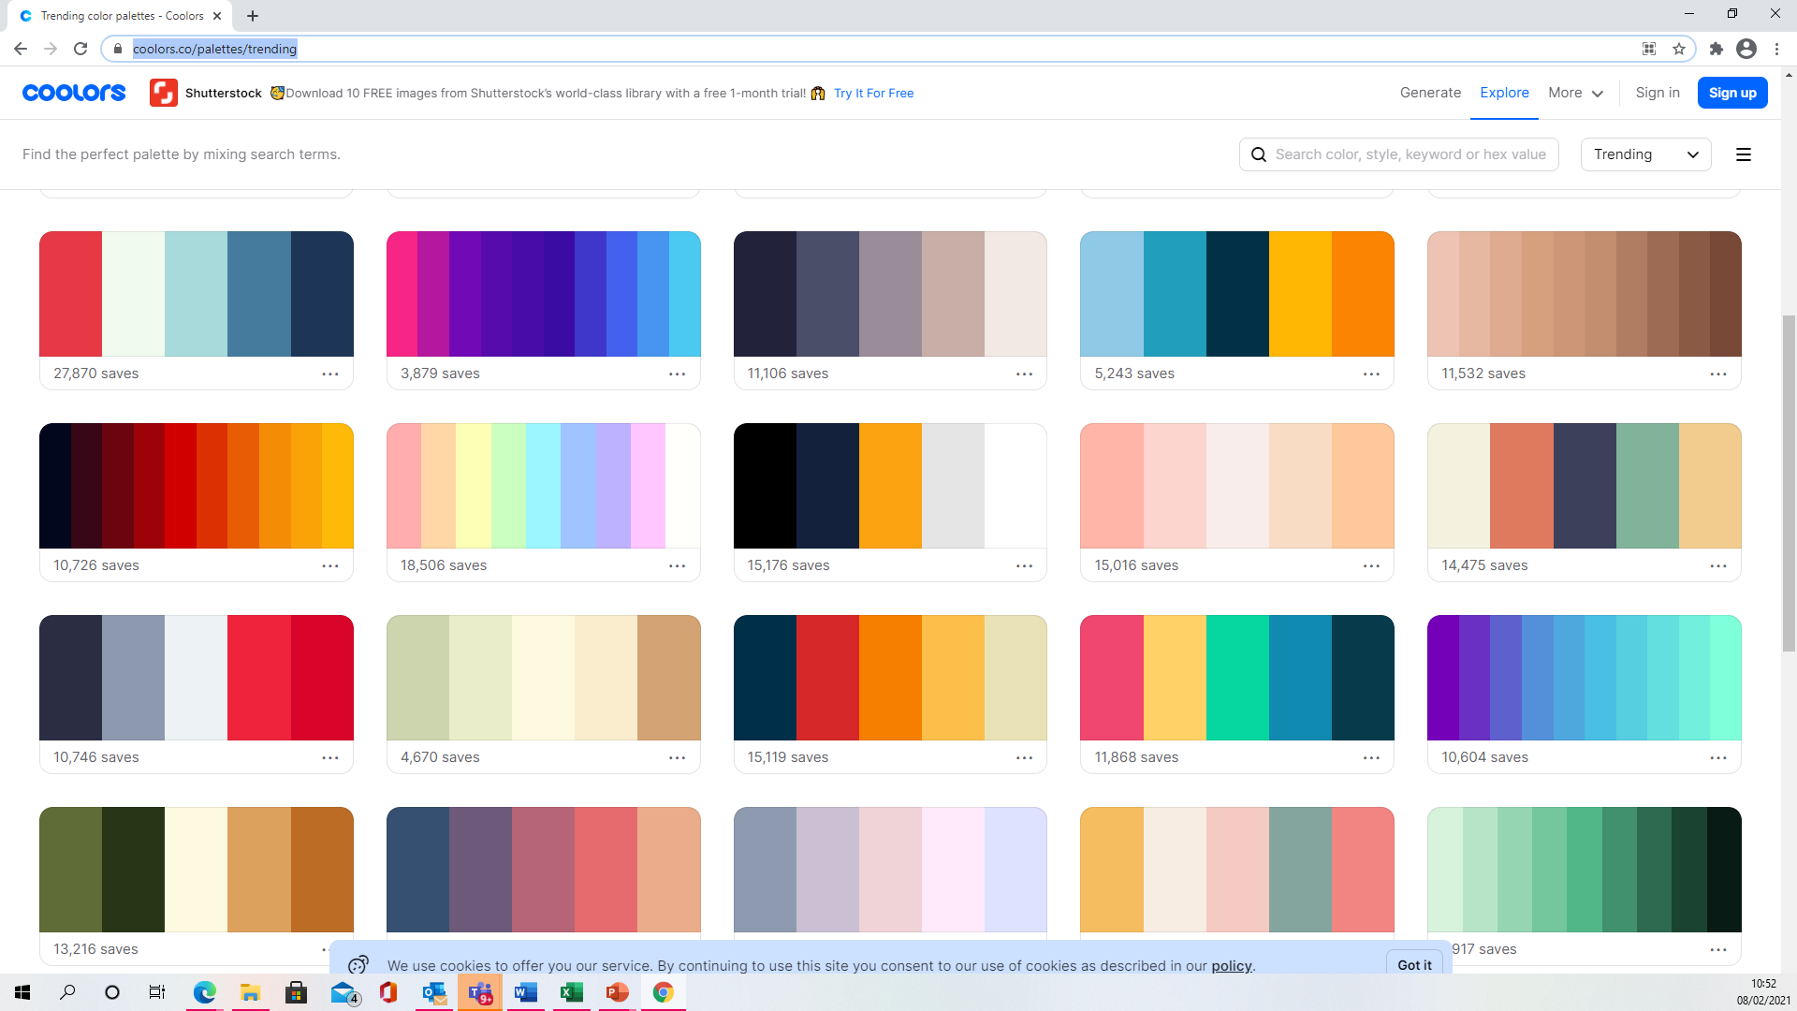
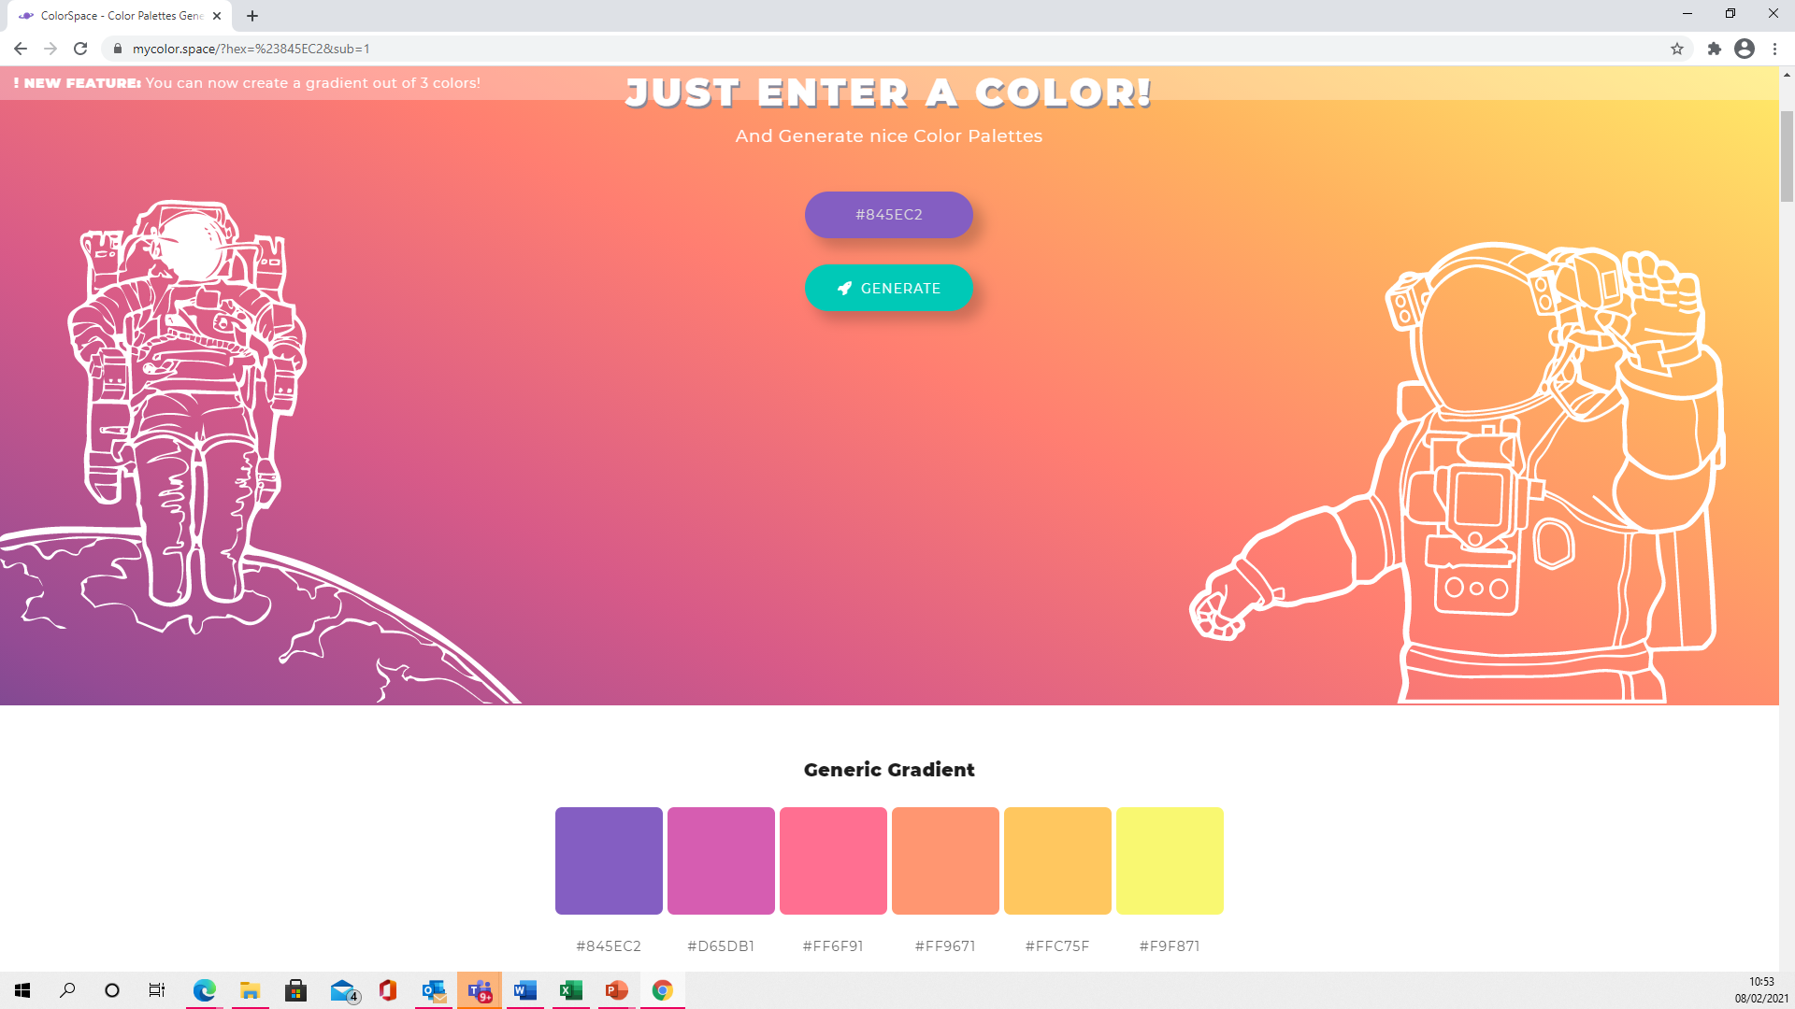
How to decide on themes?
It is all about taste but there are websites that can help:
Try these links:
https://coolors.co/palettes/trending
https://mycolor.space/
And many more!

Slide 35
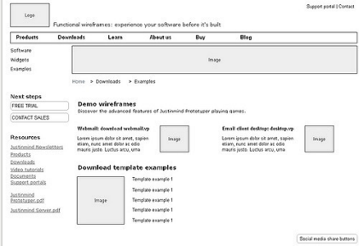
Wireframes
A tool for creating layout design.

Slide 36
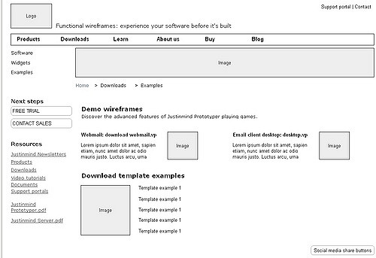
What is Wireframes?
We use it to decide on the structure of the website.
Before we even decide the visual design.
Wireframes are the ‘blueprint’ to agree on the usability of the website.
Much easier to fix and change on paper.

Slide 37
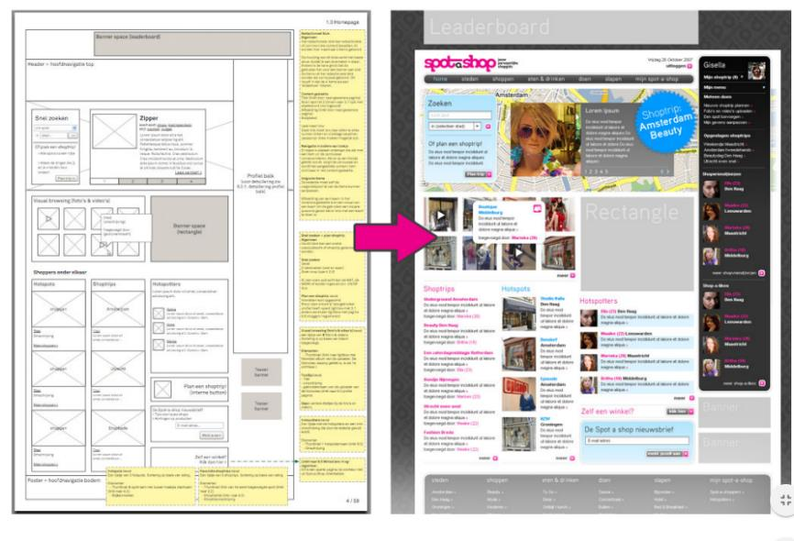
What is Wireframes?

Slide 38
What is Wireframes?
Structure: How will the pieces of this site be put together?
Content: What will be displayed on this site?
Information: Hierarchy of how is this information organized and displayed?
Functionality: How will this interface do?
Behaviour: How does it interact with the user? How does it behave?

Slide 39
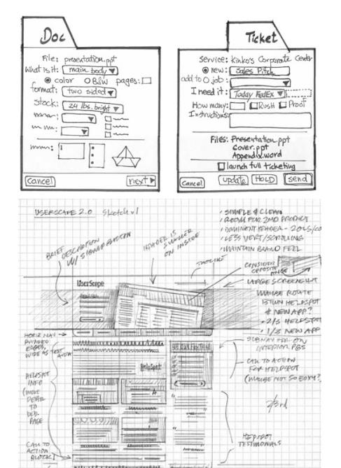
Types of wireframes:
Sketches:

Slide 40
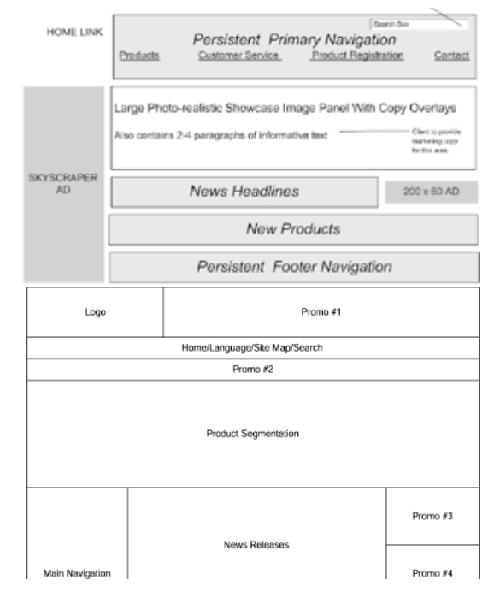
Types of wireframes:
Block diagram:

Slide 41
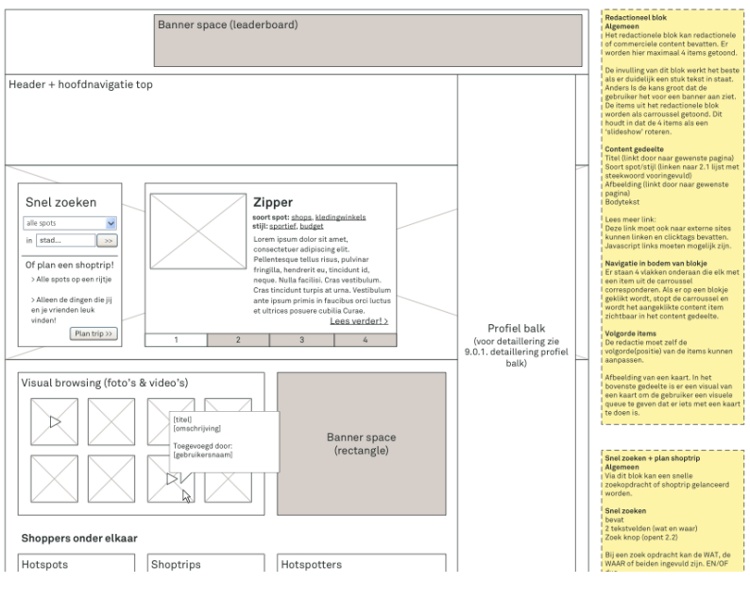
Types of wireframes:
Detailed:

Slide 42
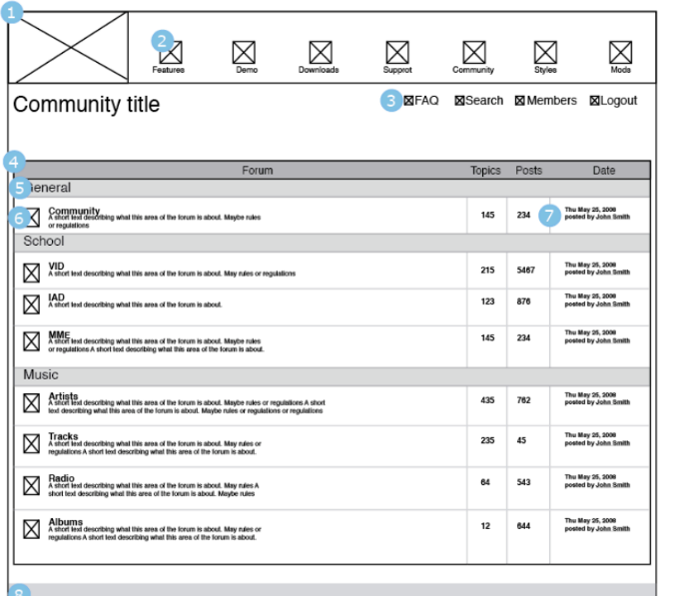
Example of wireframes:

Slide 43
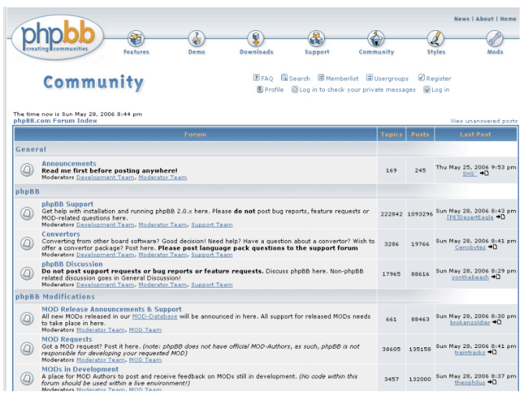
Example of wireframes:

Slide 44
End of Part 3
Activity 4.3. Planning the Wireframe early is critical part of web planning because:
We make sure what structure we need to have before we start
We ensure the design is approved by the users.
Reduce time to build and develop later.
All of the above.

Slide 45
Demo of Draw.io
Part 4
Where to test it?
http://www.draw.io
We will do a class demo.

Slide 46
Demo of Draw.io
Where to test it?

Slide 47
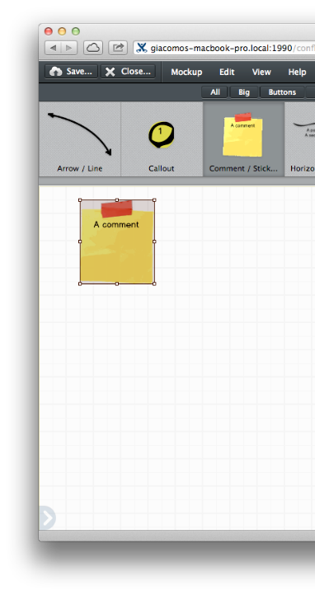
Balsamiq
Another tool for creating layout design.

Slide 48
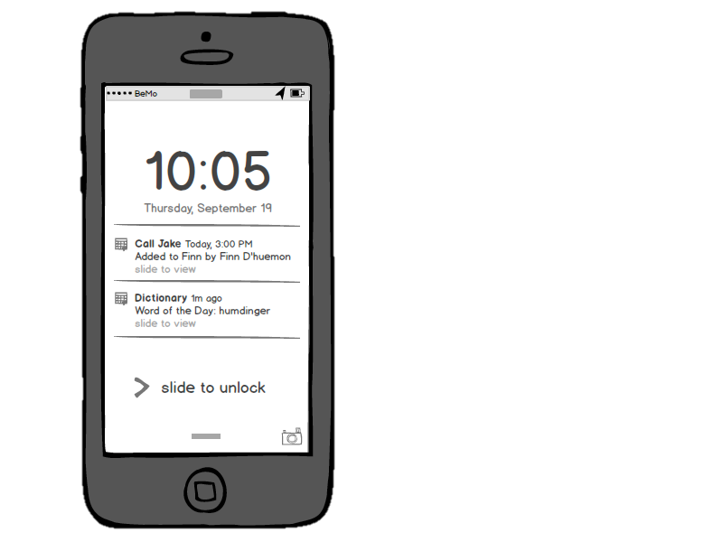
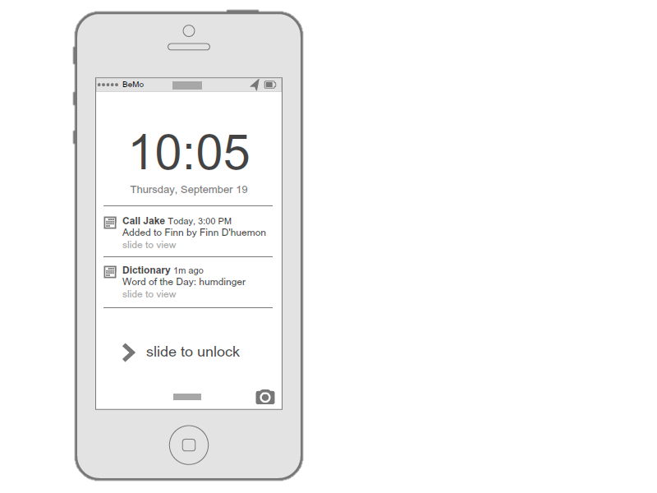
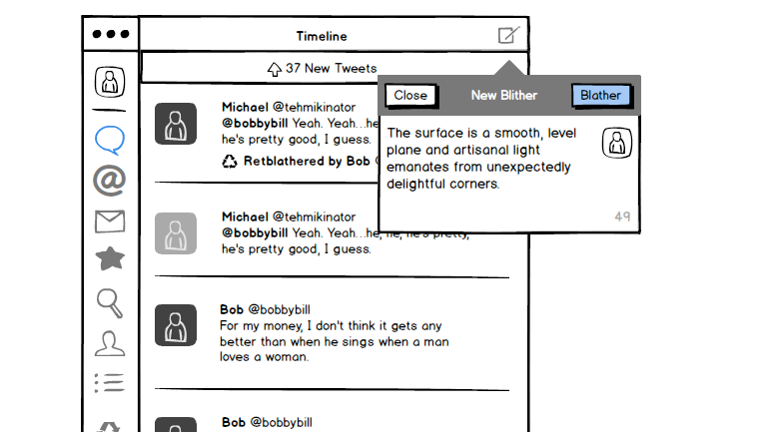
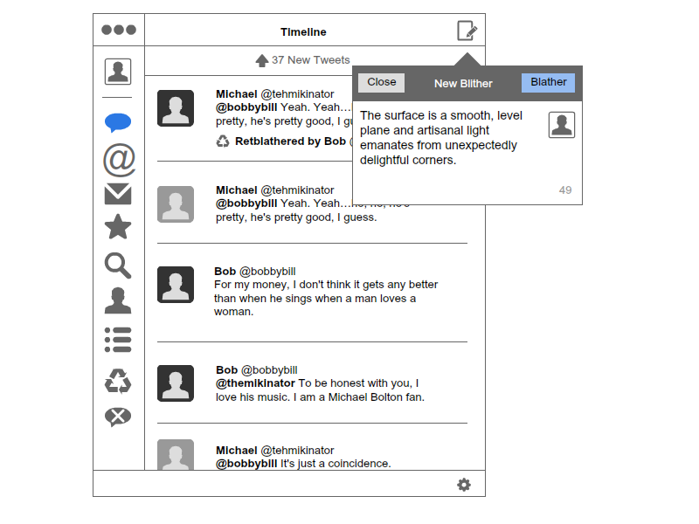
Allows prototypes,
Sketchy look and feel

Slide 49

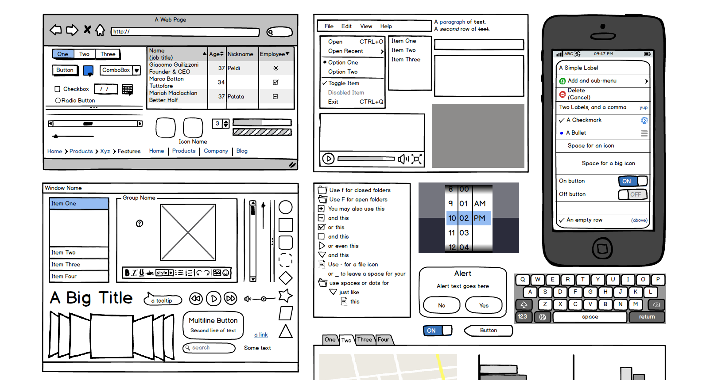
Drag and drop UI libraries

Slide 50
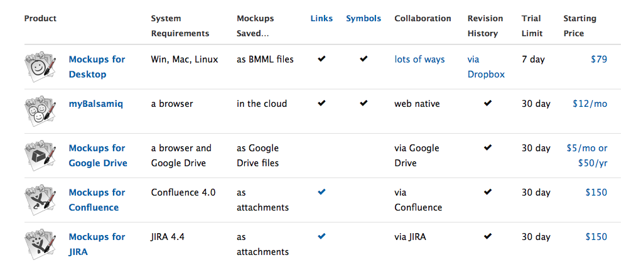
Which version should I use?

Slide 51
Where can you get it?
Not free:
https://www.mybalsamiq.com/signup
http://balsamiq.com/download/

Slide 52
End of Part 4
Activity 4.4. Open Draw.io and create a quick navigational structure, any structure, and upload a copy of it.
Only image format is accepted.

Slide 53
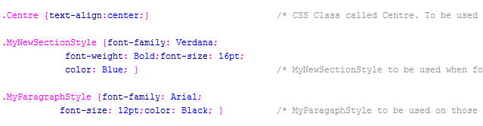
Good Code Practices
Part 5
53

Slide 54
Good Code Practices
Add indentations to your code to make clean structure.
Comment on your code to explain what you are doing and define unclear variables.
Use pictures the correct size: The whole page with pictures should not exceed 1MB in size.
Clean your pictures (We will learn this later in the term).
Use pictures with appropriate formats: JPG and GIF.
Make regular back ups in variety of locations: Machine, USBs, Online and in an Email.
54

Slide 55
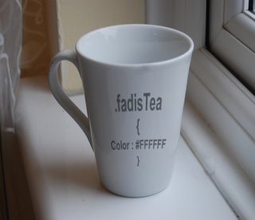
Test your website
Test your website as you build it with appropriate validation tools: http://validator.w3.org/
At every milestone:
Test your website from a different computer
Test your website using variety of different browsers.
Test your pictures and links work.
Show the work to your client to get comments on progression.
Show your work to possible customers for feedback.
Make corrections before you proceed and repeat feedback process if the changes are significant.
55

Slide 56
Documenting your work
Documentation of your website should be a continuous process, not as final activity.
This may include:
Outline agreement
Analysis and planning
Navigation and outline
Source Code
Testing records
And finally a manual of the website.
56

Slide 57
Have you started the assignment?
Please read the assignment.
You should be able to do tasks 1, 2, and 3 by now.
Ask your lab tutor about your assignment.
They are the ones will grade your work.
Complete your case study before next week to get ‘formative feedback’ in the class.
If you get stuck, email me fadi@uel.ac.uk

Slide 58
End of part 5:
Activity 4.5: Which one of these is good coding practice when building your web page online? (Select as many)
Writing comments next to the code to explain it.
Using high resolution (HD) quality images.
Using PNG images and avoiding JPG images.
Making regular backups of our work.
Validating our page codes.
Let ideas flow as we develop, early planning restricts imagination.

